Slide 1



SMART GROCERY LIST GENERATOR
Team Name: Assurant Team 1
Team Members: 1. Surya Praveen Adivi
2. Aishwarya Turlapati
3. Jui Mhatre

Slide 2

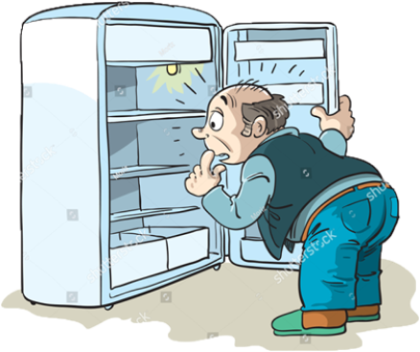
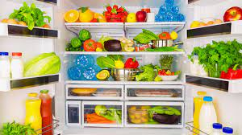
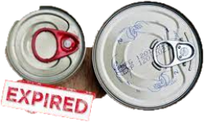
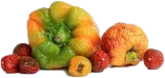
Motivation
Hungry?? Come Let's check our Refrigerator!!

Slide 3
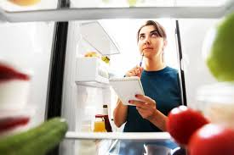

We explicitly need to go and find what there in our fridge and what’s about to empty
We need ……….

Slide 4
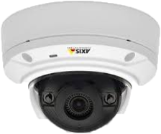
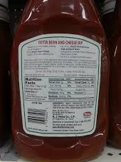



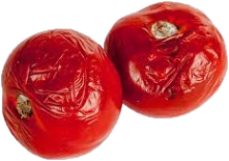
Methodology

Slide 5
Planning
Quality Check
Groceries
Rotten??
Finished?
(Aishwarya)
Scan Refrigerator for Items
Quantity Check
Bottle / Carton
Expired??
Finished?
(Jui)
Expiry Check
Pouches
Expired
(Surya)

Slide 6

Quantity Check
Input
Output
height filled: 80
std_height : 220.0
amount of bottle filled: 36.3%
import cv2
Library Used:

Slide 7
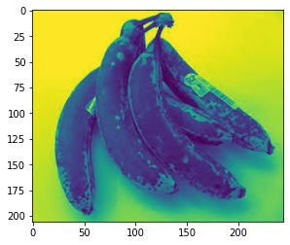
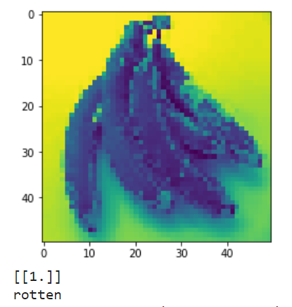
import tensorflow as tf
Quality Check
Input
Output
Detected Rotten
import tensorflow
Library Used:

Slide 8
Demo

Slide 9
Future Scope
Learn user’s diet and suggest changes to improve eating habits
Can be used in gardens to remind about watering them
Automatic ordering of generated list from recommended stores by user
Expand Idea to entire pantry, other rooms (study room…unclean desk reminder)

Slide 10
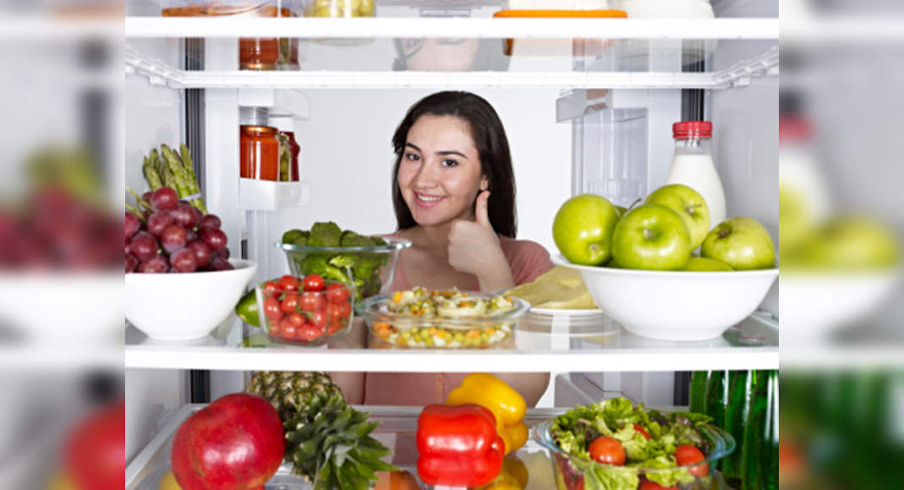
Let’s use this new idea to keep our grocery stock updated and fresh!!
Thank You!!
Stay Hungry, Stay Foolish
Stay Wise, Be Satisfied

